Slide 1
Simple Starter Circuit (SSC)
Created by
Nita Leighton
Copyright Fall 2015
ETEC 648

Slide 2
Steps required to design a Printed circuit board (PCB)
1 – Draw a freehand sketch of circuit
2 – Capture design in a schematic drawing using expressSCH
3 – Create a Node layout and Node list
4 – Link schematic drawing to PCB program in expressPCB
5 – Layout the initial design for a PCB in expressPCB
6 – Redraw schematic in Multisim, test it by simulating it

Slide 3
Start with a typical Freehand Sketch
Sketch this
drawing onto
a piece of paper for practice
Sketches like this happen in industry all the time
Therefore, you need to be able to read them easily

Slide 4
Express SCH
Here is the link: http://www.expresspcb.com/
and image of the homepage, so you will recognize it when you find it on the Internet
You will use this site for both expressSCH & expressPCB

Slide 5
Free CAD Software
Free Computer Aided
Design (CAD) Software
Pull down menu
Select software package
and install on computer

Slide 6
When programs are installed
This is the icon for expressSCH
(for schematic capture)
Once installed, these icons should show up on your desktop as shortcuts, wherever you chose to store the apps
This is the icon for expressPCB
(for PCB Layout and Design)

Slide 7
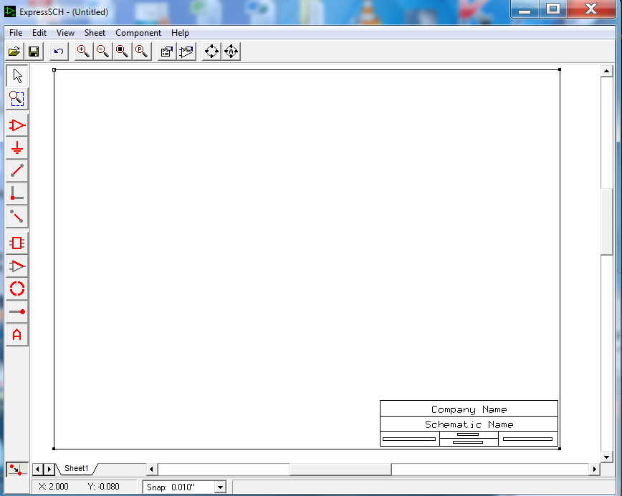
Open express SCH
This is the opening page
Pull down menus
This is what the
expressSCH
capture screen
looks like
The symbols at
top, and along
the left side, are
what you will use
when drawing
the schematic
Typical
grid pattern,
if zoomed

Slide 8
Save project
As soon as you open the schematic window – SAVE IT;
Continue to save, after each step, to preserve your work
To save:
go to file and pull down to save as initially
then, in future saves, just click save, or use the little
icon that looks like a floppy disc on the tool bar
Save work every few minutes, while working on it
Remember to place finished work in your ePortfolio, sub folder, and submit it to the instructor for review
Follow the timetable on the Outline of Requirements
Remember:
Time permitting, you have 2 weeks to redo and re-submit work

Slide 9
Select symbols for schematic of SSC
From ExpressSCH – Here is the list of components needed for the SSC schematic drawing; pull all from the library first, before you start to draw
Symbols will come in the center of page, move to top or side of page before you do layout
Order of found in library under these words
J1 = Connector - 2-pin – expressSCH opened on this component
P1 = Connector - 2-pin – (flipped 180 degrees) – expressSCH opened on this component
B1 = MISC. - Battery
R1 = Passive Resistor – (rotate 90 degrees right, so resistor is horizontal)
D1 = Semiconductor – LED (rotate 90 degrees right, so LED is horizontal)
SW1 = SPST Switch – (rotate 90 degrees right, so switch is horizontal and opens left to right, this symbol may have to be flipped also)

Slide 10
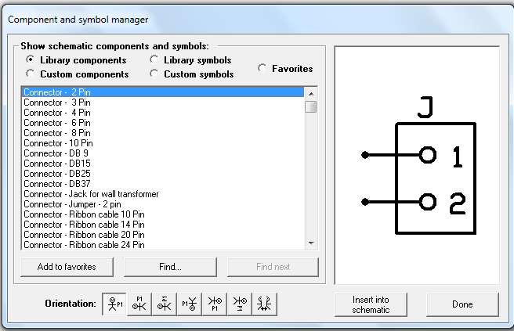
Before drawing, select schematic symbols
When you click on this icon,
third from right on top row, you will get this menu
Select,
Connector – 2 Pin
You will see this
symbol appear
Click button to insert symbol into schematic,
Then, repeat, and select second connector

Slide 11
Select other schematic symbols
Repeat steps in previous slide for
B1 = Battery,
R1 = Resistor
D1 = LED and
SW1 = Switch
Use find button to save time scrolling through long lists
The specific information needed to find them in the expressSCH library, is on slide 9 Selecting Symbols for Schematic of SSC
Most of the symbols are close together in the library, so it should not take you long to find them if you use the find button and type in the name given to you

Slide 12
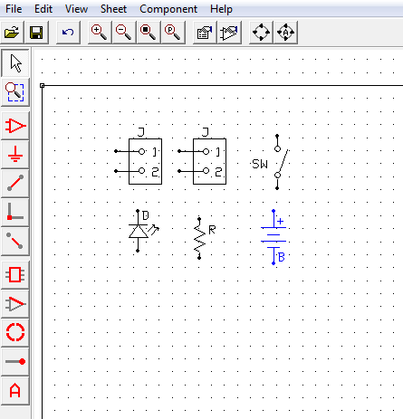
Select Symbols then, rotate or flip
All of the symbols
have been brought in
Then, these symbols are
rotated, and/or flipped –
see direction on next slide

Slide 13
Rotating & Flipping Symbols
1 - Click on symbol
that needs to be rotated,
or flipped; it will turn blue
2 - This drop down box
will appear next
3 – Then, click on rotate
or flip symbol; then the
second box appears
To flip
Rotate or flip the symbol as needed, for the schematic drawing, it is best to not include the text, so you can position text where you want it

Slide 14
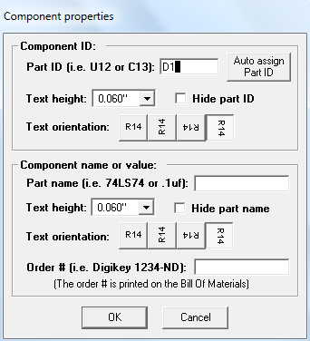
Name and number each symbol you chose
The previous slide had the reference designators (D) selected for each symbol, without the number identifier
Make sure that each of these new symbols matches with these exact reference designators (D1) that you were given
To do this, double click on the symbol and this dialog box will appear
Then, type a 1 in the first box next to the letter (D), repeat these steps for each symbol
You will have to change J2 to P for the plug, and add a 1
When finished
Click OK
each time

Slide 15
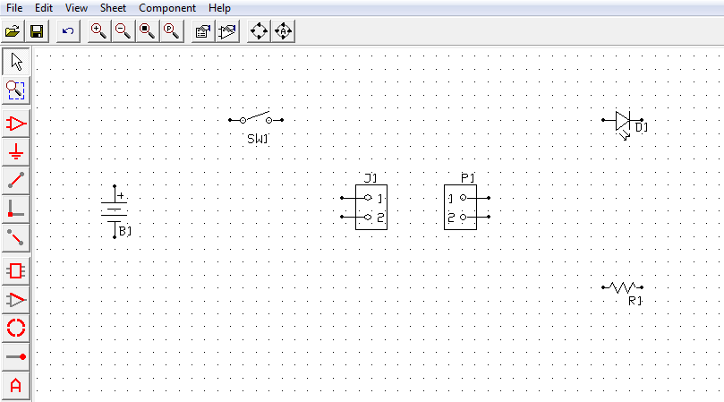
Arrange the parts layout of your design
Now, arrange the symbols according to sketch
You will have a better layout and control, if you align with the grid

Slide 16
Place wires
Use the
place wire tool
Click on dot at end of symbol,
to attach
wires, make clean right
angles at corners
For more control zoom in closer using the zoom tool (magnifying glass with the + inside). Check to make sure
ALL wires are straight and smooth, with NO zaggy edges

Slide 17
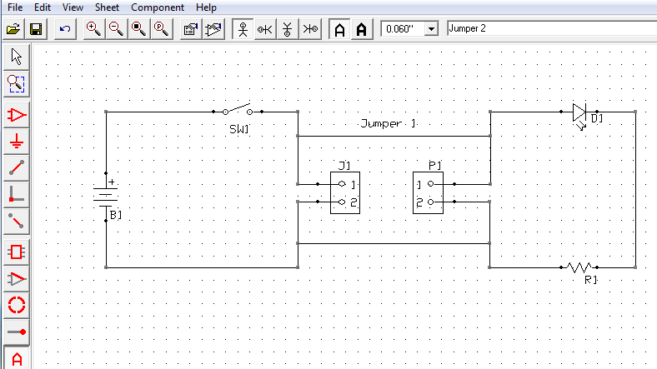
Add Text to schematic
Selection tool
Use the place text tool on the bottom left, of tool bar
Along the top, on far right of tool bar, type in box what you want to place on the schematic
To place wording just click the mouse, and drag it to where you want the text,
Use arrow, the selection tool, to move text or delete it, when its blue

Slide 18
Complete the Title Block
Dialog box appears;
type in little box at top, to say what you want to say; click OK
Click on title block area, to change words
While it is blue, use selection tool to center it in that area by dragging it
Student name
goes here
Title block

Slide 19
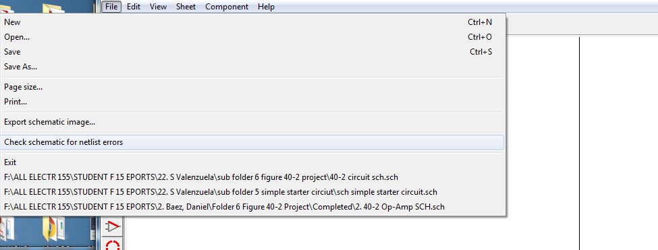
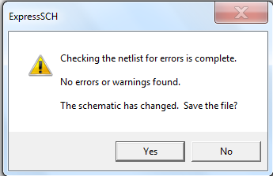
Check for errors
Under file, pull down until you come to:
“Check schematic for net list errors”
click on this, and see what appears. You want to get the dialog box below
If you have errors, you
must fix them, before you
can proceed to the PCB
design layout – repeat until
NO ERRORS OR WARNING

Slide 20
Complete schematic drawing of circuit

Slide 21
PCB terminology definitions
In expressSCH, components each have schematic symbols with reference designators to clarify which component is being depicted. Each component has more than one lead-wire (pin), and sometimes many wires on it (depending on its function).
In expressPCB, there are no schematic symbols, but rather, there are footprints and yellow outlines that represent the corresponding symbols from the schematic. The footprints are pads, either rectangular or round, onto which each component lead-wire (pin), will solder to the PCB. The yellow outlines represent the physical border of each component body. After footprints are positioned on the PCB layout, then traces will be placed between component pins that act like wires, to connect them. If linked to the schematic, then each pin that should be connected by a series of traces will turn blue, to help guide the designer, when clicked to place a trace.

Slide 22
Double-Sided PCB secrets
In expressPCB, there will be copper footprint pads (pins) and traces (wires) on both sides of the PCB—both on top, and on bottom of the board. The substrate of the pcb is fiberglass, epoxy, which is an insulator that holds all of the copper pads and traces on each side of the PCB. Red indicates copper on the top-side of the PCB, while green indicates copper on the bottom-side of the PCB. Yellow indicates the paint that will appear on the top of the PCB, in the form of silk-screen nomenclature that shows each reference designator, as well as the outline of the body of each physical component, as it will appear when soldered to the PCB. The top and bottom copper are seen as overlaying each other. Any printing on the top of the PCB can be read normally. But, any printing on the bottom will appear in an X-Ray view (backwards).

Slide 23
Transition to PCB
Now you will need to open expressPCB to link the schematic drawing to the PCB layout
Click on this icon to open the program
This window appears

Slide 24
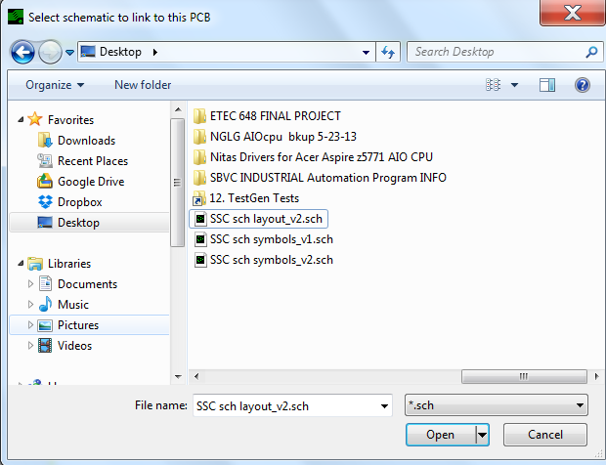
Starting Express PCB
1 – save as project
Folder 5, SSC – PCB layout
2 – Link your schematic drawing (with no errors) to this new PCB layout
3 – This dialog box
appears, type in name
of sch file; then, click
open

Slide 25
Getting started
This is the next step, click ok
and you are back to the original blank layout screen which should still be up
Select ALL the necessary symbols FIRST, before laying out the design on the
PCB for this library
Like in expressSCH click on this icon on the top tool bar, 5th from right
The details for the symbols is on the following slide
“Alphanumeric components Designators for SSC”

Slide 26
Alphanumeric components Designators for SSC
From ExpressPCB
B1 = Battery holder
SW1 = SPST Switch (part of battery holder—not separate)
D1 = Semiconductor – LED, Red in color
J1 = 2-pin Jack
P1 = 2-pin Plug
R1 = 100 Ohm, 1/4 Watt Resistor

Slide 27
Select symbols for PCB layout
Click on this icon
Either scroll down to connectors, or
use the find button; type
name to find
and select from choices
When symbol is
found, click the
insert button

Slide 28
First Symbol Inserted on PCB layout
Hollow corner
With more symbols to insert,
move this one over to side
or bottom, so they will be
out of the way, and not
covering each other up
Layout out design in upper
LEFT corner near hollow
yellow corner of PCB
outline
Look at the four corners, three are solid, and one is hollow. The hollow one is at the TOP- LEFT is stationary; it will not move; the other three are adjustable

Slide 29
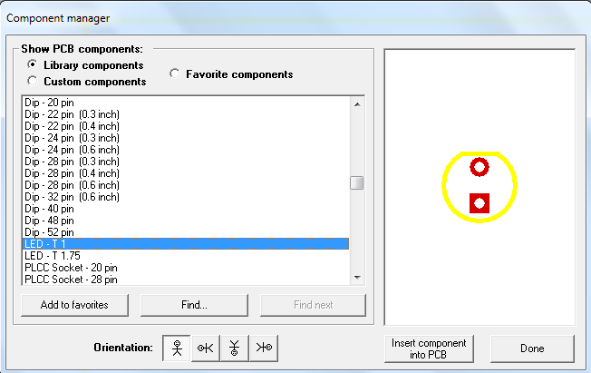
Find next two component footprints
Selecting the resistor for
reference designator – R1
Insert correct
symbol, then
click here
Select the LED
to be referenced
as – D1

Slide 30
Label footprints
Double click on footprint, and this dialog box comes up
Type in the
reference
designator,
D1; click ok
Repeat
this
process until ALL
footprints
are labeled

Slide 31
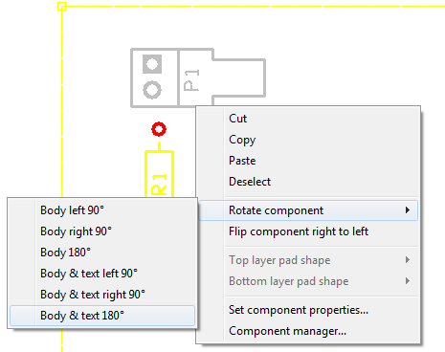
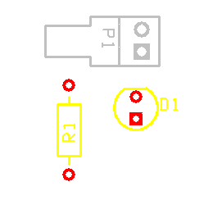
Rotate labeled footprint symbols
All footprints
are labeled
To rotate, right click while mouse is
touching symbol. The large dialog box appears, click rotate component. Small box appears and choose direction with text this time, repeat as necessary

Slide 32
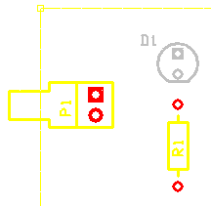
Rotate or flip footprints
You can rotate and flip these footprints, like shown on slide 31, “Rotate labeled footprint symbols”, in expressSCH
Then, place footprints in a
design layout that will be
functional
D1 is
FLIPPED
in final
layout

Slide 33
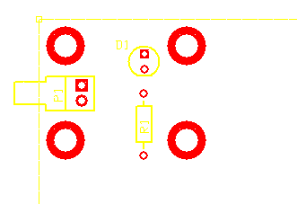
Insert Corner Mounts
This size:
0.250”
round pad with 0.150”
Hole,
works
Click on
this icon to
get the
drop down
menu on
Right; then
select the
pad shape
and size
desired
Then, click and place pads; adjust with selection tool. At least three pads determine a plane, when well distributed

Slide 34
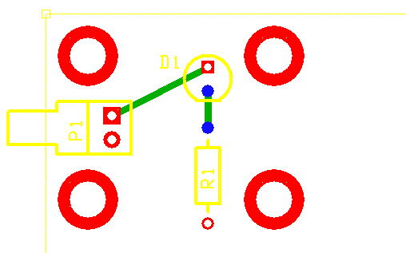
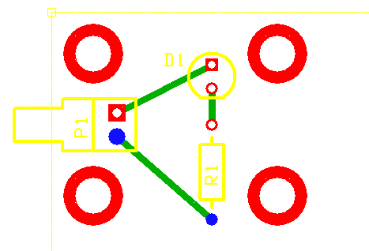
Placing Traces (wires)
Trace 1
Click this icon to place a trace
Click this icon for green trace
Trace 2
The blue dots appear, tell you what pads on what footprints to connect with traces after you click on any one of those pads (pins).
Trace 3

Slide 35
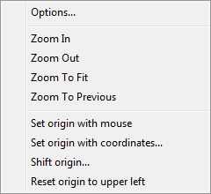
If the layout disappears from screen
Choose
Zoom To Fit and all
re-appears
If your layout disappears off the screen, click on view on top tool bar, and this box pops up

Slide 36
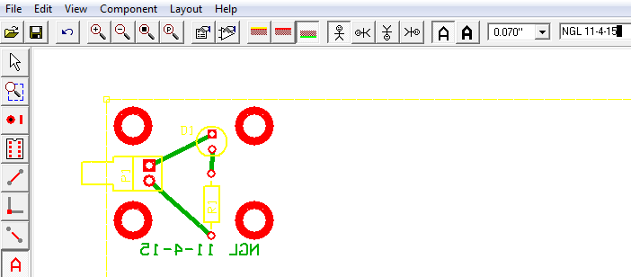
Add Text
Typed here
3 - First text placed on PCB, is in mirror image (reversed) on bottom of PCB (X-Ray view)
4 - Second text placed
1 - Click on the
Place text icon
2 - Type text in box
on top tool bar
5 - Last text placed,
it will also be green
when clicked after
being placed (X-Ray view, PCB bottom)

Slide 37
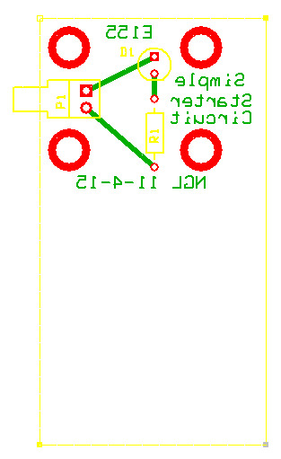
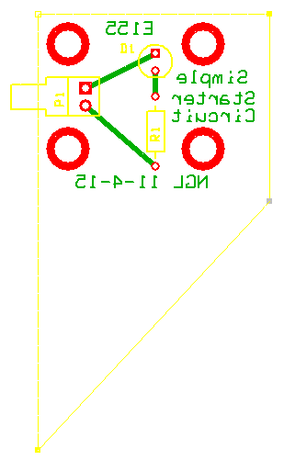
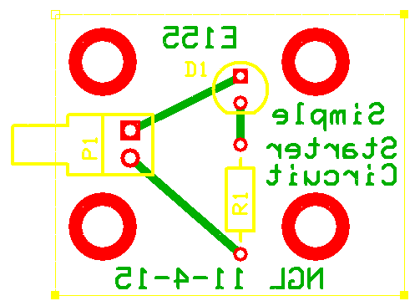
Shrink the PCB size (border)
Pull in one
corner
Pull in the
second
corner
Pull in the
third
corner
Keep trimming off
extra space, leave
a tiny margin, as
seen on this zoomed-
in view

Slide 38
Node-listing Method (1)
Methods used in node-listing:
Draw color lines (loops) from one component to next, BUT DO NOT CROSS any wire until you get to a component. A component or device is called a constituent which is a member of one or more nodes
Count the number of constituents in each node, write the number of them at end of node list in brackets { }
Number the nodes around the circuit. Follow a logical pattern.
Indicate in what area of the schematic the node is locate (map)
(CL = Center Left area; TM = Top Middle area)
Horizontal locations are: Vertical locations are:
L = Left T = Top
C = Center M = Middle
R = Right B = Bottom
Stay consistent with letters around the schematic. Use CAPITALS for easier reading

Slide 39
Node-listing Method (2)
Create a legend showing what color was used for which node
To make sure you account for EVERY component used in a circuit
Ensure that every component is attached
Make sure that NO wires or components are left dangling with one end not attached
You need to indicate unique ends on each component – examples
Resistors: use an “A” on one side and a “B” on other side
Diode: use “A” for Anode-end and “K” for Cathode-end
Battery: use the Plus sign (+) and the Minus sign (-)
Transistor: use “E” for Emitter, “B” for Base and “C” for Collector
If a component already has unique lead names, then use them

Slide 40
Insert schematic Into Paint program
First, take a picture of the whole computer screen, including your finished schematic drawing (zoomed in) by hitting the PRINTSCREEN key (usually above the INSERT key on most keyboards). Then, open Paint, where Paint can be found under accessories on the Start menu. The icon for this program looks like this:
Click once in the Paint drawing area. Then, hit Ctl-V to paste the screen into Paint. Next, lasso the part of the schematic you want to keep. Hit Ctl-X. Click File-NEW on the menu. Tell it NO, you don’t want to save. Then, hit Ctl-V. Then click SAVE AS, give it a name and hit return (Picture must be a jpg)
Now, you are ready to outline your nodes in color.

Slide 41
Open Paint
Drawing area
Remember to save this work too
This is the initial screen that appears when you open up Paint
The white area is the drawing area

Slide 42
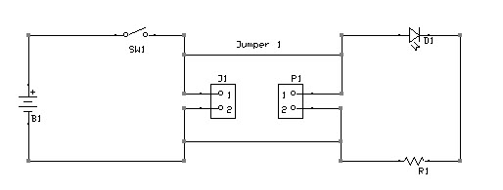
Bring the JPEG picture of the schematic into paint
color palette
Line tool
and sizes (smallest)
jpg image
Paste jpg image into Paint first

Slide 43
Start to Paint
Node 1
Node 2 (is in progress)
Use the line tool, and choose the color to draw the node lines.
Each node is a different color. Label each node on the schematic.
Continue to outline all the other nodes using these steps.

Slide 44
This is the Completed Node-layout in color
Node 1
Node 2
A
K
A
B
_
Node 3
A
B
Node 4
When you choose the colors for the nodes, try to use colors that
will look different from each other. Under some lighting, similar
colors may look the same. This planning will make better contrast.

Slide 45
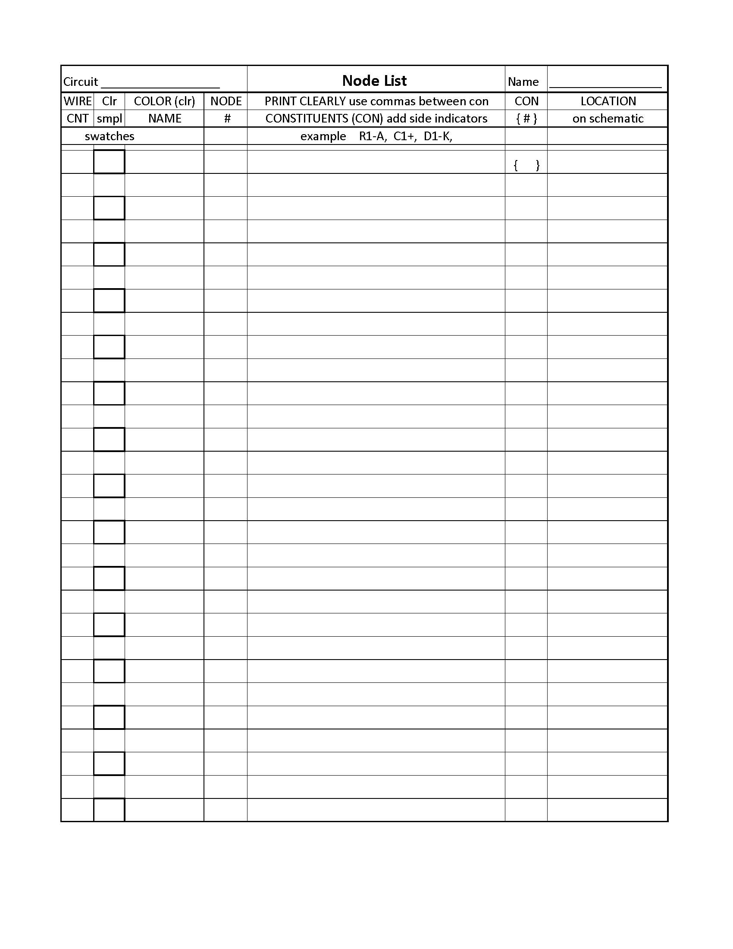
Node Listing, custom Form
Used regular #2 pencil for most entries
Column 1 = Count wires per node
Column 2 = Place color sample in highlighted squares only
Column 3 = Write name of color
Column 4 = List Node number
Column 5 = Print constituents, add side indicators, use comma to
separate constituents
Column 6 = List number of constituents per each node, in brackets { }
Column 7 = Indicate the location of the Node on the schematic using
initials T, M, B and L, C, R

Slide 46
Node-List for Simple Starter Circuit
Legend
From Express PCB (write color name in pencil only, not color)
PURPLE = Internally connected Node # 1 (inside Battery Holder) B1+, SW1– A; = {2}
RED = Node # 2 = SW1–B, J1–P1, P1–P1, D1–A; = {4}
GREEN = Node # 3 = D1–K, R1–B; = {2}
BLUE = Node # 4 = R1–A, P1–P2, J1–P2, B1-; = {4}

Slide 47
Node List Completed

Slide 48
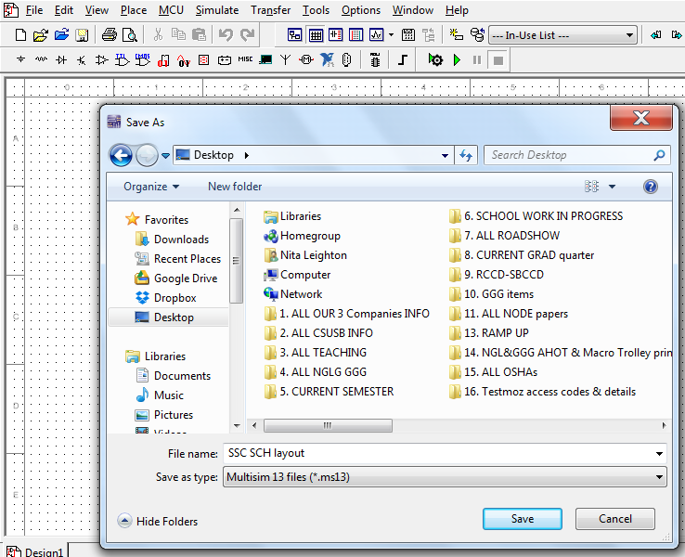
Now, repeat the schematic capture inside of Multisim
This is the first screen you will see
Save to folder 5, SSC
Save as SSC SCH layout
Save your work constantly

Slide 49
List of ref-designators Needed, with values required
In red are the reference designation (B1) for the symbols
After the = are the names, descriptions and the values that are required for this circuit to work properly
B1 = Battery, 2 each, 1.5V AA batteries = 3V
SW1 = SPST Switch
D1 = LED T1, Red in color
J1 = 2-pin Jack
P1 = 2-pin Plug
R1 = 100 Ohm, 1/4 Watt Resistor

Slide 50
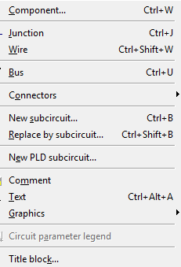
Select each schematic symbol and value
To find the symbol, go to tool bar, and click icon showing there, or go to Place on the top of the tool bar rows; click the
drop down menu; and click on
components
Then, the following boxes that
will pop up; see following slides

Slide 51
Select the switch
Insert the symbol,
once the correct one
is selected; click OK
Starting from left, select:
Family Category;
Description;
Symbol;
Footprint info

Slide 52
Select the resistor
Click OK
to insert this symbol
Starting from left:
Family Category;
Description;
Symbol;
Footprint info

Slide 53
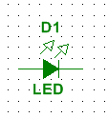
Select the LED
BE VERY CAREFUL WHEN SELECTING SYMBOLS – SOME ARE ONLY
VITUALS ONES LIKE THIS ONE
AND CANNOT SIMULATE, and
appears green on schematic
(must appear blue
in order to simulate)
Click OK
to insert this symbol (if not simulating)
Starting from left:
Family Category;
Description;
Symbol;
Footprint info

Slide 54
Select the REAL LED
Click OK
to insert this symbol which turns blue on schematic
Starting from left:
Family-Category;
Description;
Symbol;
Footprint info

Slide 55
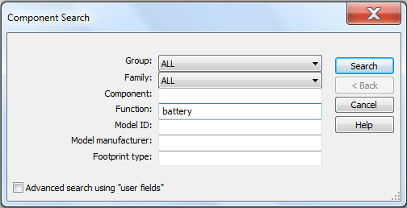
Select the battery
When cannot find symbol
in list, use search button
Click OK
to insert this symbol
Starting from left:
Family Category;
Description;
Symbol;
Footprint info

Slide 56
Select Working the battery
Start by clicking on ground symbol
to get this window
Starting from left:
Family Category;
Description;
Symbol;
Footprint info
This battery
is a place holder; it will not simulate
Again, follow the steps to label new battery B1 when installed

Slide 57
Select the connectors
Click OK
to insert this symbol
Starting from left:
Family Category;
Description;
Symbol;
Footprint info

Slide 58
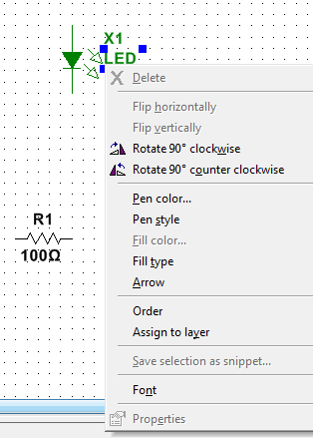
Capture the schematic
Place the symbols;
then, rotate LED
before attaching with wires
Rotate ¼ rotation,
Counter-Clockwise

Slide 59
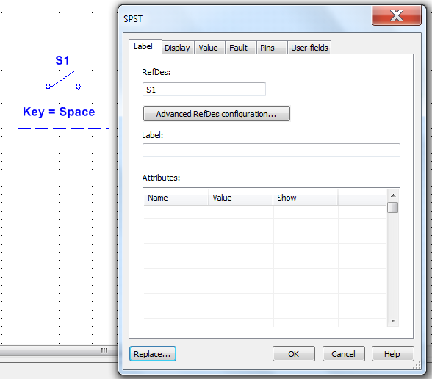
Label Symbols
Finish label, click OK
Repeat for all symbols
that need to be rotated
Double click on symbol
This window pops up Click on label and Change reference designator to match original (SW1)

Slide 60
All Labels are changed here
These labels were changed to match the original schematic in expressSCH
(Changes are: V1 is now B1; S1 now SW1; J2 now P1; X1 now D1)

Slide 61
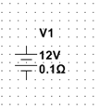
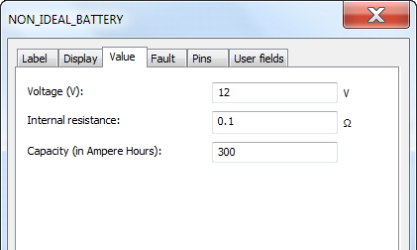
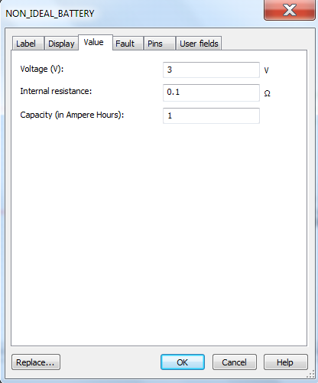
Change component values
Old label and value
Original value settings
New label and value
New value settings
Click on label tab
to access this
window

Slide 62
We are now Ready for wires to be placed

Slide 63
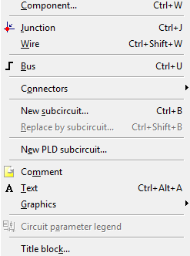
Place wires between components
To PLACE each wire,
go to top tool bar; click Place
Then, click Wire and start connecting the terminals of each symbol with a wire

Slide 64
Completing Traces
There is more than one way to attach wires. Click the symbols at
the lead, and a wire appears. Click at a corner to change directions.
Drag mouse to continue to next symbol; and right click to disconnect

Slide 65
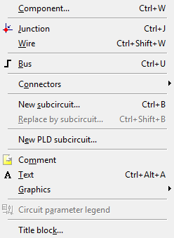
Add additional wires & text as needed
To add the jumper wires, Place junction dot
on each side; then attach new wire between 2 dots.
From the same window, add text
get pop up window shown, type in box
Repeat for second jumper, or copy and paste it

Slide 66
Replace Green virtual led
Replace
Virtual LED
The virtual LED will not function, it is a placeholder only, it must be replaced

Slide 67
Selecting New LED
To remove
virtual LED
First, remove
connecting
wires
Then, click
component
to delete
Next, go to
diode icon
and click
The LED_red is the correct component, for this
schematic when you plan to simulate the circuit

Slide 68
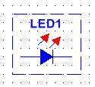
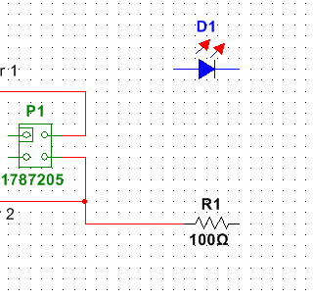
Place and Rotate New LED
Move LED into location
Rotate LED 90 degrees
counterclockwise
Re-label
component
from LED1
back to D1
Then, reattach the wires between
P1 and D1
D1 and R1

Slide 69
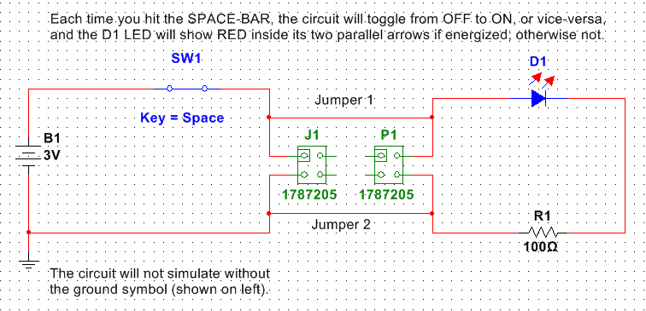
Simulate circuit operation
Toggled off
Toggled on

Slide 70
conclusion
By the end of this lesson students will be able to:
1. Draw a simple schematic layout using expressSCH
2. Create a Node Layout and Node List
3. Design a simple Printed Circuit Board (PCB) using expressPCB
4. Draw and simulate a simple schematic layout using Multisim
Students should now be familiar with the software programs that will be used throughout this course. They should be able to move more quickly through future assignments, with the knowledge gained from this one lesson, and expand that knowledge into more complex assignments, with each new folder.

Slide 71
Required Survey
ELECTR 155 Students
Please take a few minutes to answer the following 30 question survey. You must answer every question. Thank you in advance.
Go to:
https://testmoz.com/599887/admin/question/
You will see a box come up that says:
Survey for eLearning Students.
Student Login:
First and Last name required
Passcode:
ETEC648STSURVEY
All CAPITALS and no spaces (front, behind or in-between)

Slide 72
Simple Starter Circuit--Done
Created by
Nita Leighton
Copyright Fall 2015
ETEC 648

