Slide 1
Teaching and Learning Methods Though the Ages
Nita Leighton
Winter 2018
EDUC 605 Foundation of Education
Copyright 2018 by NPD Corp. All Rights Reserved

Slide 2
Ancients who taught
according to our textbook: Foundation of Education by Ornstein, et al (2017):
Chinese, with Confucius,
the Egyptian,
the Hebraic,
the Greek philosophers,
and Romans
Copyright 2018 by NPD Corp. All Rights Reserved

Slide 3
Chinese, with Confucius 2000 BCE – 2000 CE
Ancient Chinese, they had three different philosophies:
Legalism
established an authoritarian government
maintained order
used education to indoctrinate people (p. 49)
Taoism
more humane than Legalism Yin and Yang
encourage reflection to find one’s true self
take path to truth (p. 49)
Confucianism
education’s is to create and maintain a harmonious society
everyone knows his or her status, duties, & responsibilities (p. 49)
http://www.francislewissocialstudies.com/confucianism2.html
Copyright 2018 by NPD Corp. All Rights Reserved

Slide 4
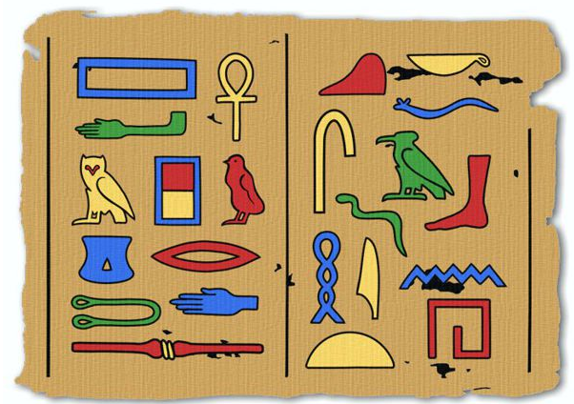
The Egyptians and Greeks 3600 BCE – 400 BCE
Their histories are entwined
Egyptians influenced the Greeks on:
“…government, philosophy, the arts and sciences, and medicine…” (p. 54)
Egyptians taught scribes
to reproduce their written language of hieroglyphics
Egyptian Hieroglyphics
Alphabet
http://www.artyfactory.com/egyptian_art/egyptian_hieroglyphs/hieroglyphs.htm
Copyright 2018 by NPD Corp. All Rights Reserved

Slide 5
Hebraic education 1350 BCE – 150 BCE
Children taught by:
listening,
reading,
memorizing,
expected to internalize the lesson’s meaning and message
build group cohesion and identity (p. 56)
http://www.returntogod.com/free_stuff/summary.htm
Copyright 2018 by NPD Corp. All Rights Reserved

Slide 6
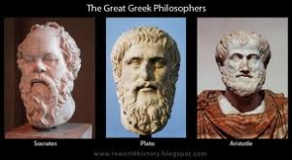
The Greek Philosophers
Use “power of education as narrative storytelling to transmit education” (p.57) Education vary throughout Greece
Socrates (469-399 BCE) who believed in universal truths, asked leading questions that stimulated students to think deeply about and reflect on the meaning of life, truth, and justice” (p. 60).
Plato (427-326 BCE) Did not believe that men were intellectually superior to women. Men and women should receive the education that was appropriate to their intellectual abilities” (p. 63).
Aristotle, (384-322 BCE) as a realist, believed in teaching by using objects. These natural objects were broken down into three categories: animal, plant and mineral. He based his curriculum on object
classification.
http://www.choicesunlimited.ca/who-are-you/aristotle-plato-socrates/
Copyright 2018 by NPD Corp. All Rights Reserved

Slide 7
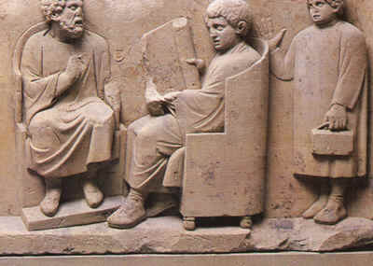
Ancient Romans 800 BCE – 800 CE
Used homeschooling for sons of elite
Family history
Respect and honor family duty, the state, and their gods
Learned self control, rights and rituals, and prayers for gods
Received military training
Rome introduced primary schools in end 4th century
Ages 7 through 12
Literacy important
Greek Grammar school
Ages through 16
Composition, literature, poetry, & history (p. 66)
Higher education at rhetorical schools
Combine Greek concepts with Roman politics
& law
http://www.historylearningsite.co.uk/fileadmin/historyLearningSite/roman_10.jpg
Copyright 2018 by NPD Corp. All Rights Reserved

Slide 8
Middle Ages (500 – 1400 BCE) Renaissance (1300 – 1600 BCE )
During the Middle Ages – the Catholic church and various religions had great influence over education
Monastic schools training for priest or brothers for men
’women’s curriculum’ of embroidery, spinning, weaving, & painting” (p. 69).
During the Renaissance (began in the 14th century)
The educate person new both Latin and Greek this lasted to end of 19th century
The privileged received more education than the common class, who in turn received more than the lower class, who may have only gotten a little education, if any, if they were lucky
Copyright 2018 by NPD Corp. All Rights Reserved

Slide 9
The Reformation, The Enlightenment
During the Reformation (1500 CE – 1570 CE)
“the Protestant Reformation gave renewed emphasis to the role of religion in education” (p. 81)
“…schools were and are sponsored by churches, temples, synagogues and mosques” (p. 81).
Comenius felt that children needed to be treated with care and kindness
children learn most efficiently when they are developmentally ready
During the Enlightenment (1690 – 1780 BCE) period of the 18th century
had new ideas they wanted to explore about teaching
they watched children play as well as do projects and activities regarding the world around them
Copyright 2018 by NPD Corp. All Rights Reserved

Slide 10
Rousseau, Pestalozzi, & Herbart
Rousseau’s (1712-1778) concepts were forerunners to constructivism
He wanted students to understand the world in which they lived
Pestalozzi (1747-1827) divided teaching into “general” & “special” areas
General set the groundwork
Special or specific objects: animals, plants, rocks & man-made
This follows what Aristotle did using objects
Johann Herbart’s (1776-1841) goal was to create a systematic approach to teaching using five steps:
preparation, presentation, association, generalization and application (pp. 97-98).
Copyright 2018 by NPD Corp. All Rights Reserved

Slide 11
Froebel, Spencer, & Dewey
Froebel (1782-1852) for created kindergarten
a student of Pestalozzi, took his objects to be more symbolic, and thus inspired recall
Herbert Spencer (1820-1903) wanted to stop teaching the classics, and be innovative in the late 19th and early 20th centuries
Promoting engineering and applied technology, along with the different sciences of biology, social science and physical science
John Dewey (1859-1952) is considered a pioneering experimentalist
At his post at the university of Chicago in 1896 he created his Laboratory School and within it ‘miniature society’ and an ‘embryonic community’
Children learn problem solving and working together – hands-on
Copyright 2018 by NPD Corp. All Rights Reserved

Slide 12
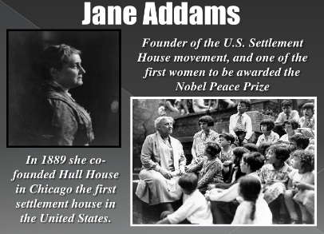
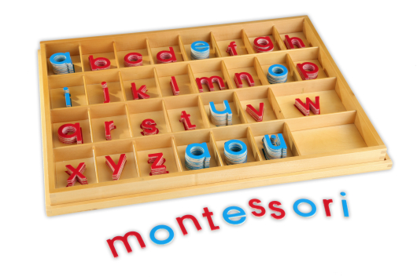
Addams, & Montessori
“Addams (1860-1935) wanted public schools to feature a multicultural curriculum that included the history, customs, songs, crafts, and stories of ethnic and racial groups” for women (p. 108)
creating a sense of community
Maria Montessori (1870-1952) broke barriers
working with mentally or impaired children, she created ways to bring out their needs to succeed
https://image.slidesharecdn.com/unit2powerpointimmigrationandindustrialization-110829110831-phpapp02/95/unit-2-powerpoint-immigration-and-industrialization-23-728.jpg?cb=1314616295
https://www.google.com/search?q=montessori+images&tbm=isch&source=iu&ictx=1&fir=pOhiWNQWrkW94M%253A%252COyiWcfGSY-4-JM%252C_&usg=__MWUFtJM-A-j6a8erEwW-0GYykfc%3D&sa=X&ved=0ahUKEwi416uuuOrZAhUl8IMKHULbA8kQ9QEINzAG#imgrc=pOhiWNQWrkW94M:
Copyright 2018 by NPD Corp. All Rights Reserved

Slide 13
Piaget, & Freire
Piaget (1896-1980) “…discovered that children construct their concepts about reality by actively exploring their environment (p. 112)
Here again another teacher wanting children to be aware of their surroundings and use the information they collected whenever
A precursor to the later theory of constructivism
This idea had surfaced before during the Enlightenment period and with Rousseau
Freire (1921-1997) gathered information to engage the project of completing one’s identity & meaning in a world that needs to be more equitable, humane & just” (p. 117) understand the students background
Copyright 2018 by NPD Corp. All Rights Reserved

Slide 14
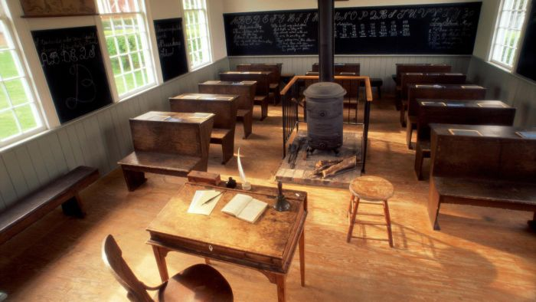
American Colonies
In Puritan New England created the Town School and the Latin Grammar School for upper class boys
Mid Atlantic area created more the parochial type of schools based of various religions
Farther south more rural – tutors
or sent children away. to school,
but not the slaves
https://images.reference.com/reference-production-images/question/aq/700px-394px/education-like-colonial-rhode-island_3423abd686c7c6d4. jpg
Copyright 2018 by NPD Corp. All Rights Reserved

Slide 15
After the Revolutionary War (1)
Franklin (1706-1790) knew importance of science, invention, and technology
His curriculum in: carpentry, shipbuilding, engraving, printing, and farming (p. 128).
He created an academy – secondary education on useful information and science versus Latin Grammar schools
By 1855 over 6000 academies with 263,000 learners
Some for boys, some for girls, some coed
By 1870 the high school started, and out numbered academies 2 to 1 by 1890
Herbert Spencer thought like Franklin
Noah Webster (1758-1843) he wanted this new country to have its own identity
Authored textbooks
Jefferson (1743-1826) “Committed to separation of church and state…” (p.129)
Copyright 2018 by NPD Corp. All Rights Reserved

Slide 16
After the Revolutionary War (2)
Benjamin Rush (1745-1813) was against the separation of church and state
believed that women should be educated, since they had intellects equal to men.
“he proposed a system of academies and colleges for women” (p.130).
This is similar to:
Plato’s thinking of equality in intellect
In the Middle Ages women educated in practical things
Jane Addams wants to educate the immigrant women
Copyright 2018 by NPD Corp. All Rights Reserved

Slide 17
Sunday School, Common School
Sunday schools educated the working youth of the early 19th century
As industrialization started – public school began
Sunday schools switched to be more religious overtone
Joseph Lancaster adopted the British monitorial educational style
Older students tutored younger ones
Common school started in the first half of the 19th century
Open to ALL children
Relied on public money and community control
Not in the South until after Civil War
Forerunner to Normal schools
Copyright 2018 by NPD Corp. All Rights Reserved

Slide 18
Normal Schools
These schools trained teachers to be teachers
Women allowed to pursue teaching careers
Catherine Beecher (1800-1876) 19th century pioneer
One room classroom in rural areas
McGuffey Readers used for 1836 - 1920
Pride of country
Literacy
Hard work
Diligence and punctuality
Copyright 2018 by NPD Corp. All Rights Reserved

Slide 19
United States is a nation of immigrants (1)
Created problems within the educational system
Varying backgrounds, cultures and languages
Plus the Native Americans
“Children learned skills, social roles, and cultural patterns…” (p. 150)
And the African Americans
Booker T. Washington (1856-1915) bend the curriculum at Tuskegee
W. E. B. Du Bois (1868-1963) helping to organize NAACP
“…adamant that a person’s career should be determined by ability and choice, not by racial stereotyping” (p. 149)
Copyright 2018 by NPD Corp. All Rights Reserved

Slide 20
United States is a nation of immigrants (2)
Latino community comprised of different cultures
“…bilingual education has become politically controversial, with some states making English the official language” (p. 154)
Asian American segregated the public-school system
the students went to separate schools
it was based on their specific language, culture and traditions.
Arab Americans faced similar challenges
They were assimilated into the American culture
They retained their Arabic roots
Copyright 2018 by NPD Corp. All Rights Reserved

Slide 21
Recent history
1970s nationally a decline in standards in skills, and academic subjects
1980s, Secretary of Education Bell, under President Reagan, created a three-step plan to raise the standards:
“(1) a basic skill and subject matter curriculum;
(2) effective schools with high academic standards and expectations; and
(3) education to improve American economic competition in the global economy” (p. 157).
2001 Congress passed the No Child Left Behind Act
2009 Obama – Race To The Top (RTTT) agenda
Common Core of today
Copyright 2018 by NPD Corp. All Rights Reserved

Slide 22
Conclusion
History repeats itself throughout the ages
As seen throughout this presentation
Some difference
Especially because of technology advancements allowed teachers to do more than ever before – especially in the last 20 years
Copyright 2018 by NPD Corp. All Rights Reserved

Slide 23
References
Ornstein, Allan C., et al, (2017). Foundation of Education 13th edition. Canada: Cengage Learning.
Images
http://www.artyfactory.com/egyptian_art/egyptian_hieroglyphs/hieroglyphs.htm
http://www.choicesunlimited.ca/who-are-you/aristotle-plato-socrates/
http://www.francislewissocialstudies.com/confucianism2.html
https://www.google.com/search?q=montessori+images&tbm=isch&source=iu&ictx=1&fir=pOhiWNQWrkW94M%253A%252COyiWcfGSY-4-JM%252C_&usg=__MWUFtJM-A-j6a8erEwW-0GYykfc%3D&sa=X&ved=0ahUKEwi416uuuOrZAhUl8IMKHULbA8kQ9QEINzAG#imgrc=pOhiWNQWrkW94M:
http://www.historylearningsite.co.uk/fileadmin/historyLearningSite/roman_10.jpg
https://images.reference.com/reference-production-images/question/aq/700px-394px/education-like-colonial-rhode-island_3423abd686c7c6d4. jpg
https://image.slidesharecdn.com/unit2powerpointimmigrationandindustrialization-110829110831-phpapp02/95/unit-2-powerpoint-immigration-and-industrialization-23-728.jpg?cb=1314616295
http://www.returntogod.com/free_stuff/summary.htm
Copyright 2018 by NPD Corp. All Rights Reserved

