Slide 1
ETEC 544
Storyboard for the Expert System
STEMO-CPAT
By Glen Graham, Michelle Romanek and Nita Leighton
Winter 2014
Notes:
This is the title of our Storyboard, and would be presented to trainees in the ES training mode sessions, for Teachers and Counselors in various schools where the STEMO-CPAT would be used. This part of the training would be run by the instructor (facilitator). The middle part would be run by the ES, in training mode. Role-playing would be done by putting the ES into survey mode, just the way that the teachers’ students would be using it. Then, the instructor would take over again, once the surveys had been administered to the teachers and counselors, for the duration of the training.

Slide 2
Welcome to STEMO-CPAT ES Training
Notes:
This is the actual first slide that trainees would see upon entering the room. It lets the participants know that they are 1) in the right place and, 2) are welcome.
Trainer and trainees are networking, getting a feel for the level of the room. Trainer conducts a text poll that allows trainees to rate their technology skills on a 1-5 Likert scale. with the 5 levels being as follows: 1-very weak, 2- weak, 3-moderate, 4- strong, 5 – very strong and the prompt could be something like, “I would rate my computer skills as…” That is VERY open to adjustment, by the way, or scrapping if you hate it. Speaking as someone who has been to A LOT of k-12 professional development (even in the past 2 years) this is fast becoming the standard because it’s so helpful for the trainer to get a feel for the room. Also, people who would rate themselves a 0 if we would let them almost always self-identify because of nerves.
Reference
http://www.polleverywhere.com/

Slide 3
What is the STEMO-CPAT ES?
STEMO-CPAT is an Expert System (ES) that has many modes.
STEMO-CPAT stands for Science, Technology, Engineering, Math, or Other, Career Pathways Assessment Tool. One mode is for training, another is for assessment, while another is for career-pathway advising.
First, it attempts to glean potential STEM professionals from among 11th and 12th grade students, many of whom would select another career path because they do not believe they can perform STEM jobs, but have aptitude and personalities that perfectly suit those professions.
Second, it matches prime assessment results of all students with their 3, best-match pathways for jobs/higher education/careers, and advises them on how to get there.
Notes:
This slide explains the name (acronym) and purpose of the STEMO-CPAT Expert System, online application software, to which the teachers and counselors are about to be introduced, and on which they will become proficient administrators.

Slide 4
Facilitator with class
Example of computer lab classroom in action
Notes:
As the purpose of the STEMO-CPAT is to help those who might typically disregard careers in the STEM fields (though we want to help those who want to go into STEM, too!), we would expect that all of your 11th and or 12th grade students would have a chance to work through the STEMO-CPAT ES. That is why we would expect you to work with the students in the computer lab as a facilitator like you see here. Each student must have their own computer as the program is designed to give individualized results. In addition to their own computer, each student must have…(see next slide)…

Slide 5
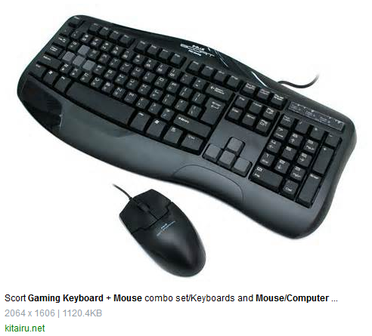
ES Computer Interface Equipment
Notes:
…their own keyboard and mouse, along with their own headphones with noise-canceling microphone. As we work through the ES in training mode, you will see that some of the questions require spoken responses and some require typing (we are quizzing the teachers/counselors/admin with spoken quizzes (that are non-ambiguous, and don’t require learning voices and speech patterns), students will need access to both, in order to get the most out of their work with the STEMO-CPAT ES.

Slide 6
Description of an Expert System (ES)
Notes:
Most trainees would want a better understanding of what an Expert System (ES) is all about, before continuing further into the training session. This should help to explain the dynamics of the survey instrument that it will administer when in survey mode. It will also help teachers to explain why different students were asked a different series of questions.
An Expert System emulates one, or more, human expert(s). It uses a computer to store the human knowledge base of an expert(s), and heuristically adapts to situations, to enable that emulation. You basically have the user interact with the computer expert through a series of questions. These questions adapt to the responses given by the user along adaptive paths determined by the programming of the ES. The STEMO-CPAT is an Expert System that will be used to assess learning styles of your students, as well as to gather information from them about their values, motivations, skills, aptitudes and preferences. The ES will collect this information from a series of questions and answers. These will be used to search for the 3 best jobs (right out of high school), as well as matches to higher paying careers, following more education.

Slide 7
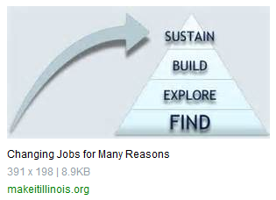
Purpose of STEMO-CPAT
Notes:
The STEMO – CPAT was designed for two main purposes. First, it attempts to glean many more potential STEM professionals from among 11th and 12th grade students than those who currently choose those careers. Often, this is simply because many of them would select another career path, as they do not believe they can perform STEM jobs, even though they have aptitudes and personalities that perfectly suit those professions.
Second, it matches prime assessment results of all students, including those who are not STEM inclined, with their 3, best-match pathways for jobs/higher education/careers, and advises them on how to get there. It will also provide a detailed roadmap to reach each one of those 3 goals.

Slide 8
PRE-TEST prompts
List up to 5 STEM careers that you have heard about previously:
List any STEM careers that you have researched:
List up to 5 non STEM careers:
Beside each of your answers above, also list what education would be required for each career.
Notes:
This is an example of the PRE-TEST prompts that the STEMO-CPAT would administer to high school students as they begin the session and before they enter the Q & A survey.
After defining STEM to students, we would administer this simple PRE-TEST, to determine entry awareness of careers and education, both inside and outside of STEM careers.

Slide 9
Example Q & A Survey Prompts
How would you evaluate yourself on the scale below for each of the following statements?
Possible Likert-Scale for ranking each statement:
1-strongly disagree, 2-disagree, 3-neutral, 4- agree,
5- strongly disagree
Statements to be ranked:
I like working with my hands.
I enjoy being outdoors for long periods of time.
I prefer working with a team/in a group.
I like finding multiple solutions to a given problem.
I prefer working alone.
I prefer to work inside.
Notes:
The STEMO-CPAT is almost entirely comprised of statements with comparisons on the Likert scale, above, or multiple choice answers. There will also be some open-response, text based answers, for which the keyboard will be used. Most other responses will be gotten from the microphone (in a non-ambiguous manner that does not require the computer to learn a student’s voice or speech patterns).

Slide 10
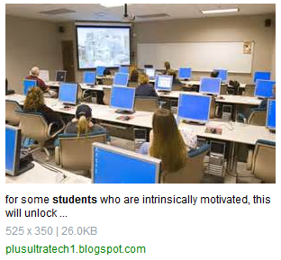
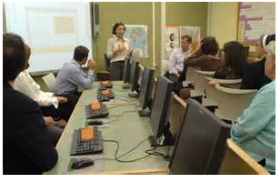
Teacher Preparation Training
ES Teacher & Counselor Training Events
Teachers using STEMO- CPAT ES with Students
Notes:
This slide shows various classroom scenarios of participants taking the STEMO-CPAT survey.
Top, right & left, show sessions with teachers and counselors using STEMO-CPAT in training.
Bottom right shows students using the STEMO-CPAT in survey mode.

Slide 11
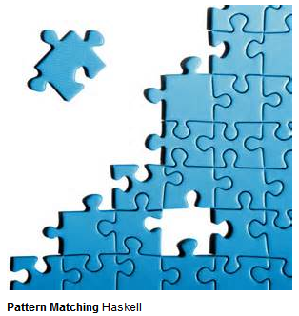
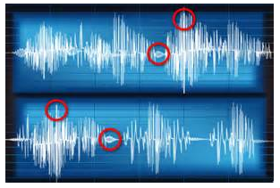
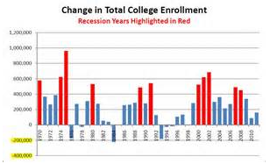
Counselor Orientation & Training
Notes:
This slide gives teachers and counselors a sense of what they can do with the output reports from the ES that results from the surveying of their high school students.
Counselors will be able to graphically show their students the different results in chart form, along with the roadmaps to get to their best-match job/education/career goals (the actual charts and roadmaps are not shown above).

Slide 12
Counselors will advise student job/education/career pathways
Notes:
This slide represents the value-added by the STEMO-CPAT to counselors, as they advise students along their best-match career paths.

Slide 13
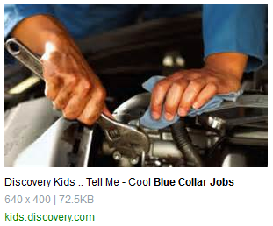
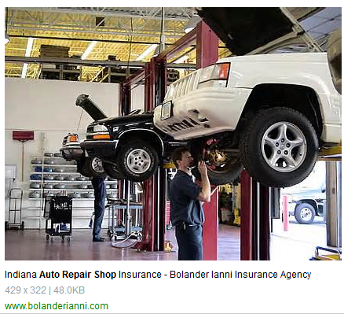
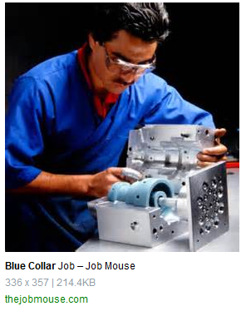
Student Pathways to Jobs
Notes:
Many jobs contain STEM elements, but are not directly STEM jobs. If students choose to go directly to work after high school, these are a few of the jobs that do not require more formal education. This slide is meant to depict those options toward which counselors might direct students, if the STEMO-CPAT so advises.

Slide 14
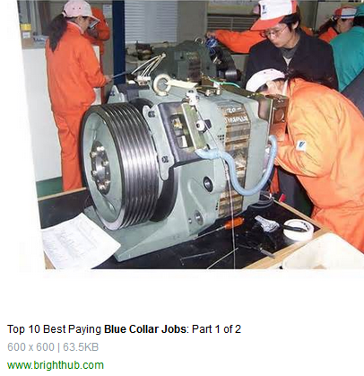
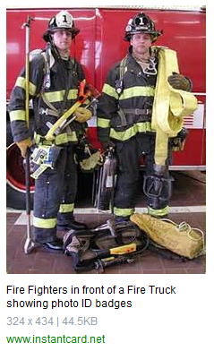
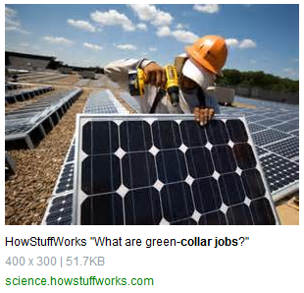
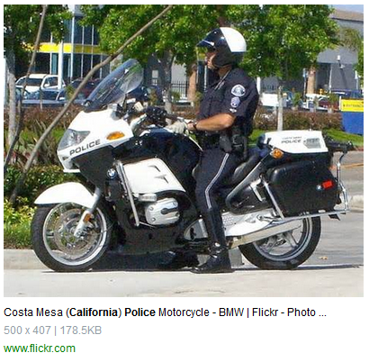
Student Pathways to Jobs and Careers (2)
Notes:
This slide depicts those intermediate positions. These careers may require some additional education, but not necessarily a degree. It may be just certificates. Or, it may be recommended, or required, that an Associate’s degree be earned.

Slide 15
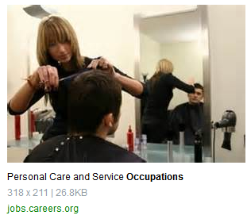
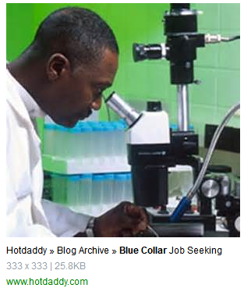
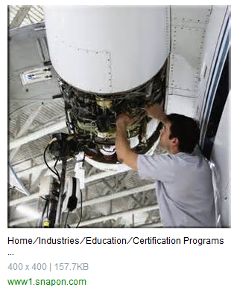
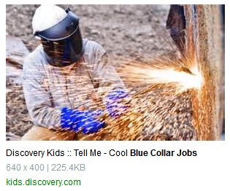
Careers with some education, getting a certificate or Associates degree a
Notes:
These careers again may require certificates, Associate’s degrees and/or board exams to qualify. This slide depicts just one, of a series of such opportunities.

Slide 16
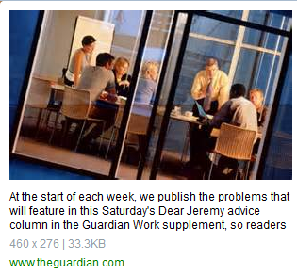
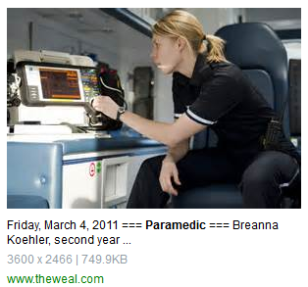
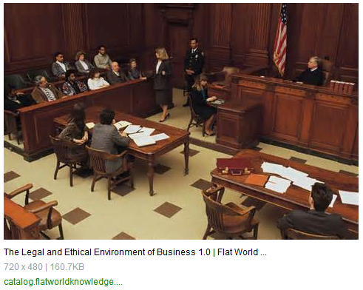
Other Careers with 2-4 year or higher degrees
Notes:
This slide shows those careers, “Other” than STEM, where more education may be required in order to reach higher pay-rates.

Slide 17
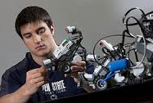
STEM Careers with a 4 year or higher degree
Science
Engineering
Technology
Math
Notes:
This slide depicts STEM careers, which cover Science, Technology, Engineering and Math. Within these four, broad areas of study are many more specific career variations.
Although, there are many different kinds of science, technology and engineering, nearly all of them use math to solve problems.

Slide 18
Transition to STEMO-CPAT role-playing
Now, the teachers and counselors will act as their students would, in a role-playing exercise. In that role, they will take the dynamic survey offered by the online Expert System, called STEMO-CPAT. It will ask them a series of adaptive questions that will assess them for prime indicators, and ultimately generate a report of the 3 best-fit pathways for each of them to take.
In this role-playing scenario, teachers and counselors will learn what it is like for students to Q&A with the system, and get a feel for that student experience. That way, they will be better equipped to answer student questions about it. It will also prepare them to answer debriefing questions from their trainer, that will measure their learning. Trainees will also compare their experiences after trading roles of teacher, student and counselor, among themselves.
Notes:
This slide indicates that this is the point in the training where teachers and counselors will pretend to be students, and actually take the STEMO-CPAT survey, as if they were different high school students. In this process, they will learn many things about this assessment tool, including the dynamics of the adaptive Q & A sequences. This will help them to both get a feel for the student experience, as well as to be able to answer student questions like, “Why did it ask Susie different questions than it asked me?”, or , “Is this machine racist or sexist?”. Just because there may be outer differences between students does not mean that the ES is discriminating against them. Teachers and counselors should tell students to expect that after the first few questions, every student will be asked a different set of questions. They must know that the STEMO-CPAT is using the responses from each individual student to direct the path of future questioning. And, those questions are based purely on internal differences in answers, rather than any outer difference.

Slide 19
STEMO-CPAT ES Trainee Assessment
The last step in the training is to assess trainee learning, to qualify users as certified.
Trainees who receive a 75% score, or higher, after assessment by the ES, in the training mode, will receive a certificate that will authorize them to be a “STEMOgrapher” and use the STEMO-CPAT to assess students in a computer classroom environment. Those who become certified will qualify to receive login credentials and password access for such system use.
Non-qualifying trainees will be able to repeat the training until they pass, based upon district retraining resources.
Notes:
This slide shows that the teachers and counselors will be evaluated for their learning by the ES, in the testing area of the training mode.
Here, 75% is the minimum threshold for a trainee (teacher or counselor) to become a certified administrator of the STEMO-CPAT ES (in basic modes).
It also indicates that those who fall below this threshold may be allowed to retest, if their district policy, and resources, allows time, and pay, for additional retesting.
It may be that not all teachers and counselors need to be certified, since multiple classes of high school students may be sent to the testing room and tested by the same certified individual.
Certified counselors will be interpreting STEMO-CPAT output reports, and advising students accordingly.
Anyone who qualifies, regardless of their specialty (teacher or counselor) will be certified as a “STEMO-grapher” and will be given administrator access to the ES, for surveying and reporting modes (but not training mode, which would require additional train-the-trainer instruction).

Slide 20
(as in Hollywood storyboards)
THE END

Slide 21
References
http://drpop.org/2010/01/how-to-make-a-storyboard/
https://www.google.com/search?site
http://images.search.yahoo.com/search/imagesh

